Slide 1

Mall Customers Analytics
Bornita Das
Ishan Tickoo
Yihan Xiang

Slide 2
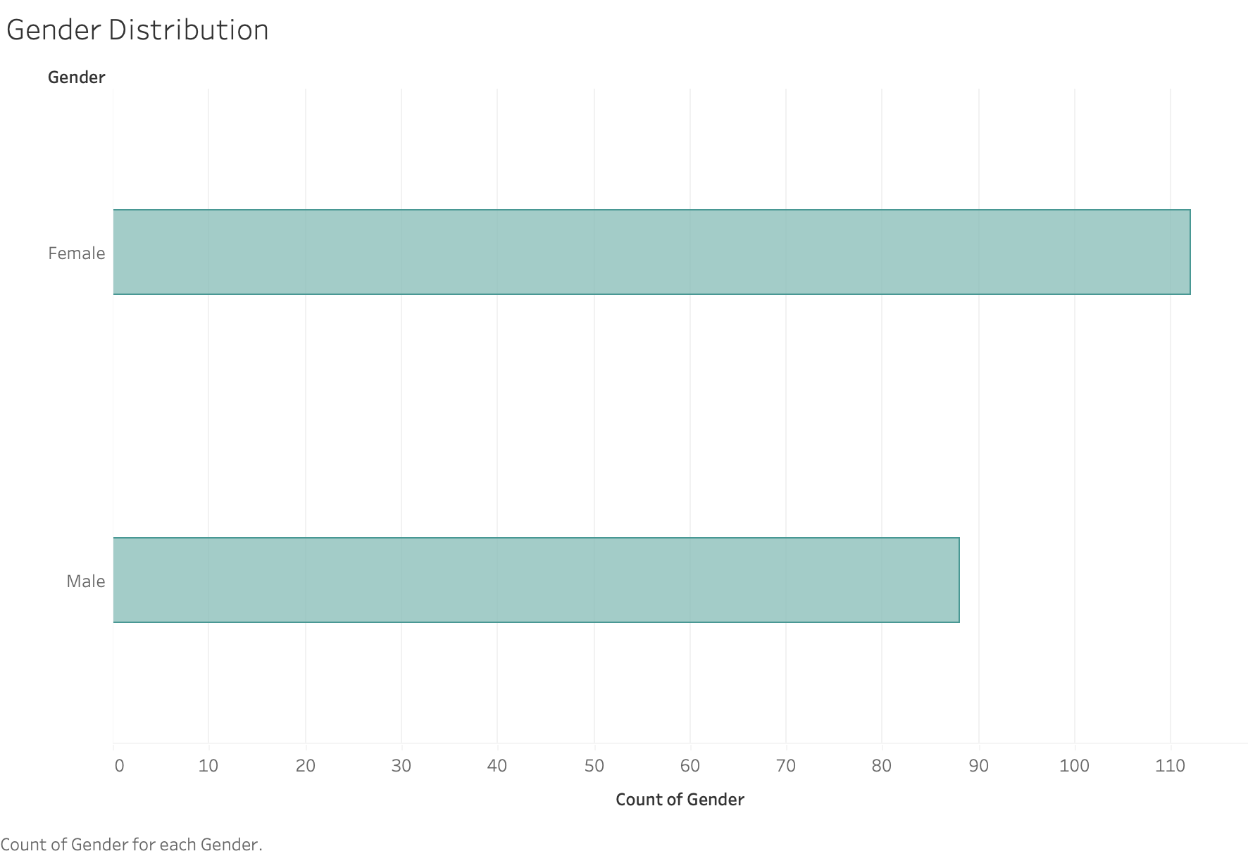
Total Sample Set - Male Vs Female Ratio

Slide 3
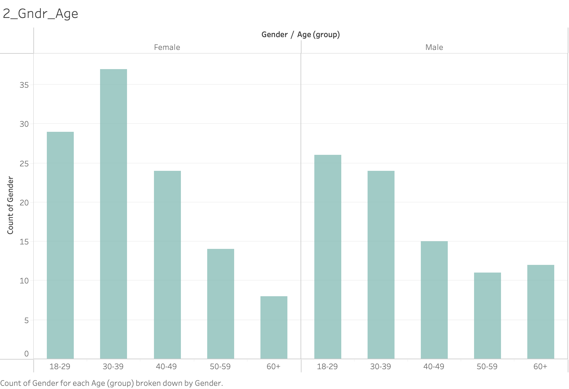
Sample Set -Demographics

Slide 4
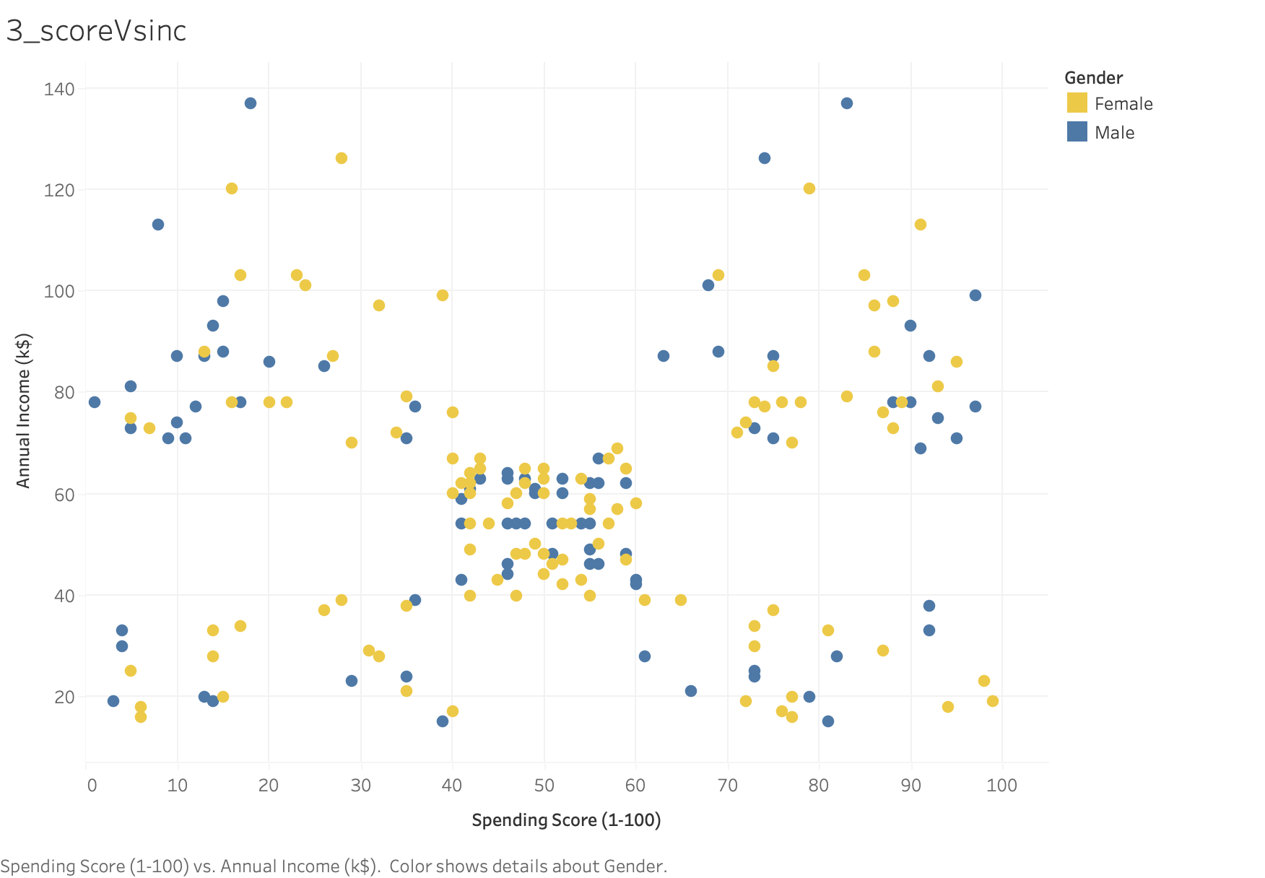
Relation between Income and Spending Score

Slide 5
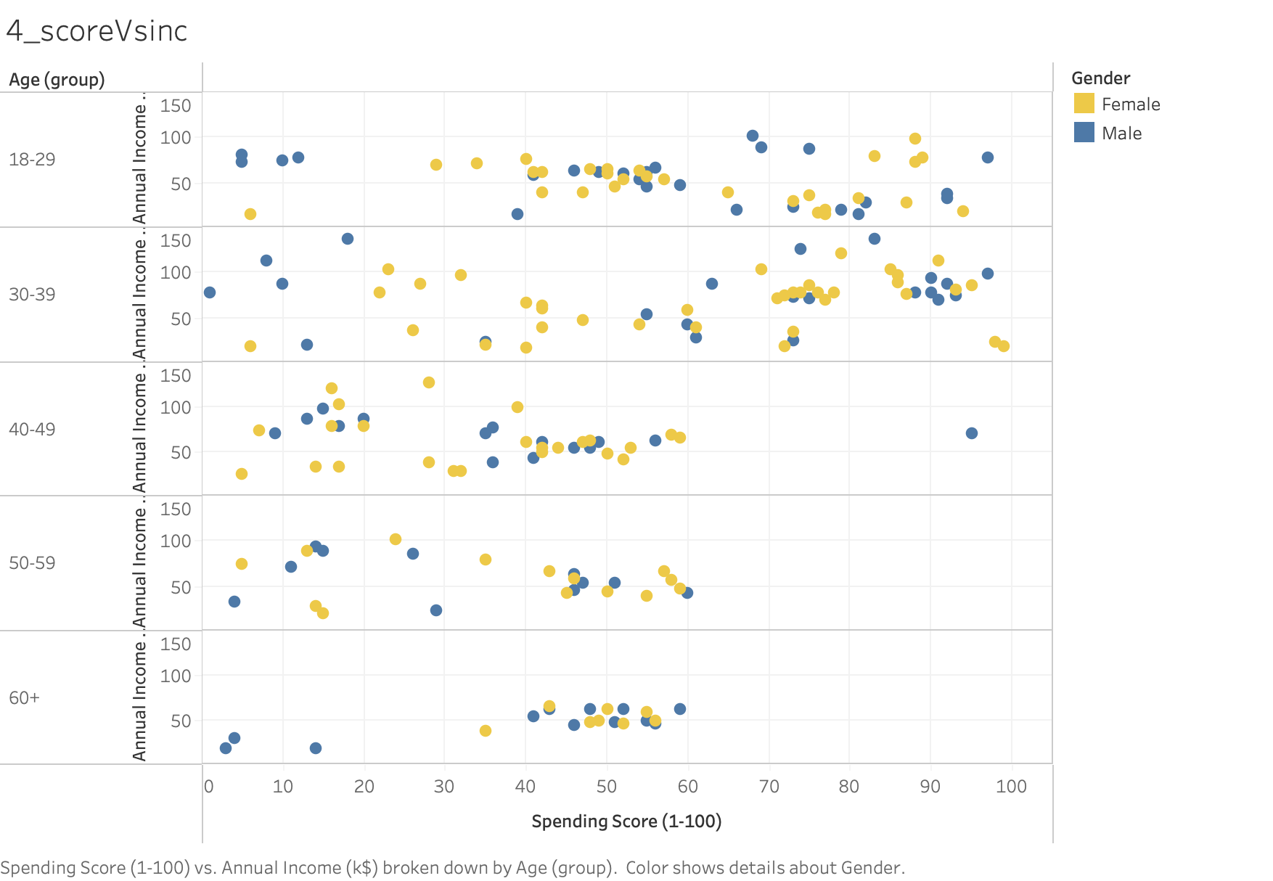
Deep Dive - Relation between Income and Spending Score

Slide 6
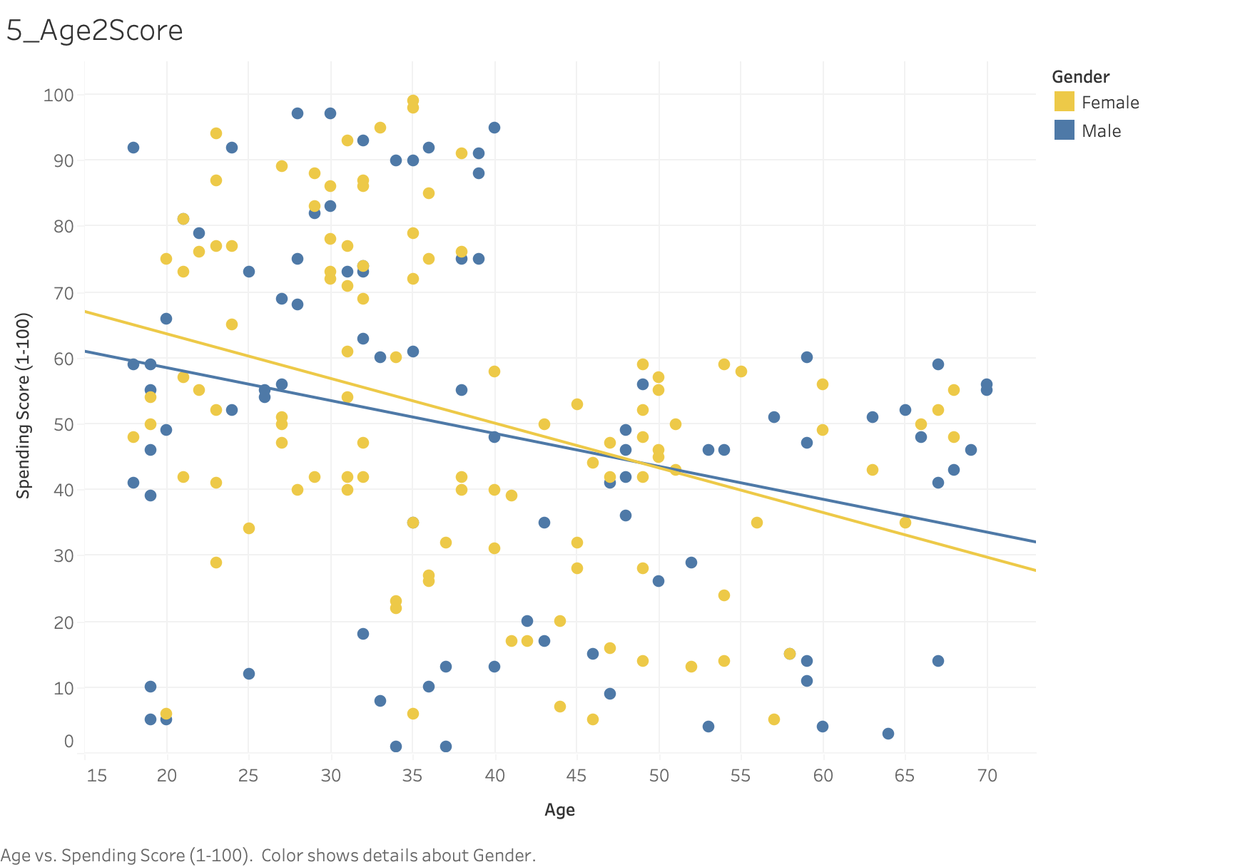
Relation between Spending Score and Age

Slide 7
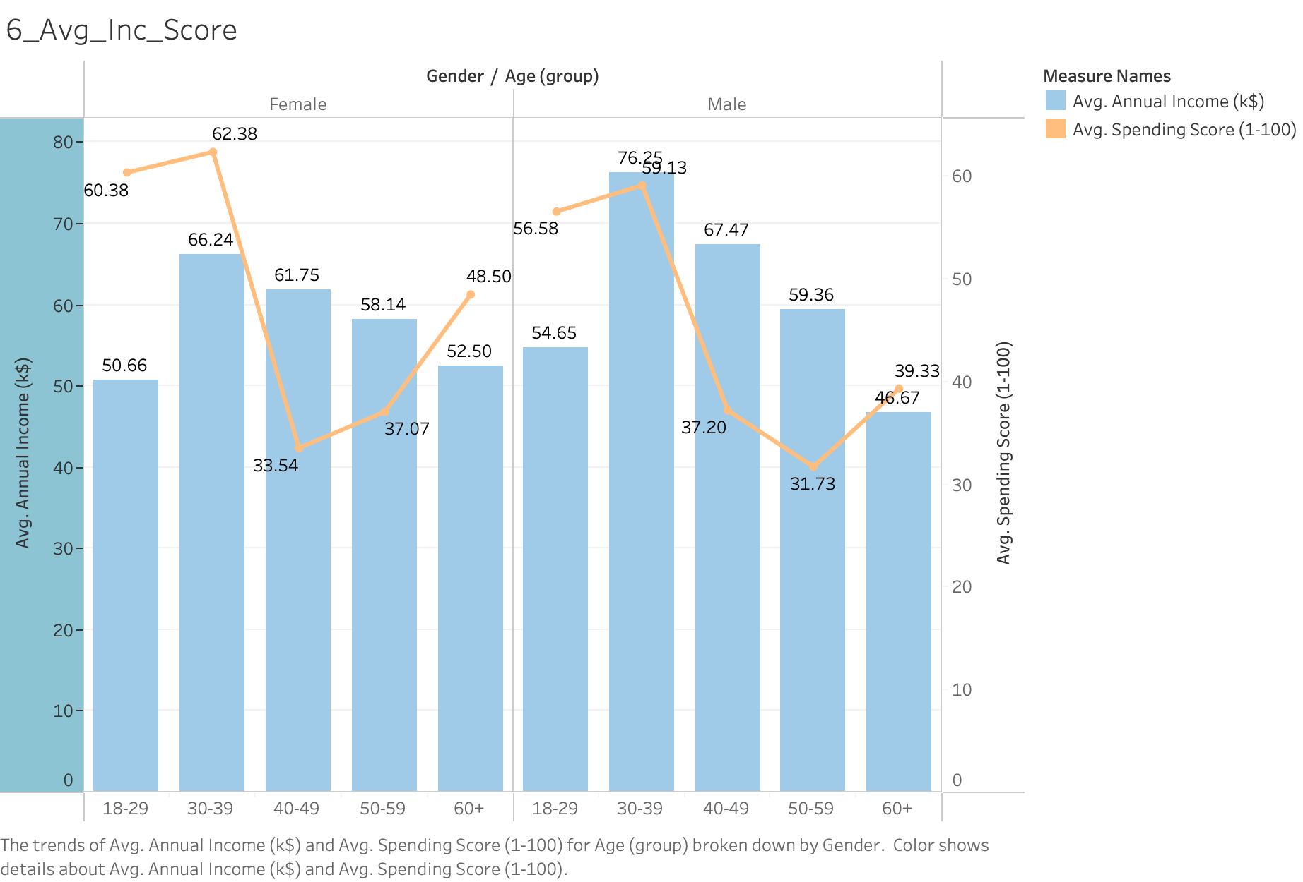
Avg. Spending Score Vs Avg. Income by Demographics

Slide 8
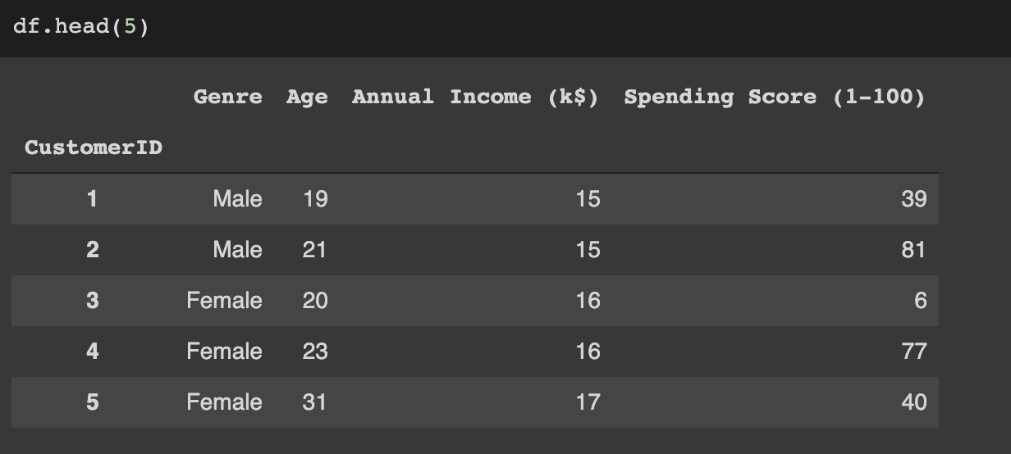
Analysis in Colab

Slide 9
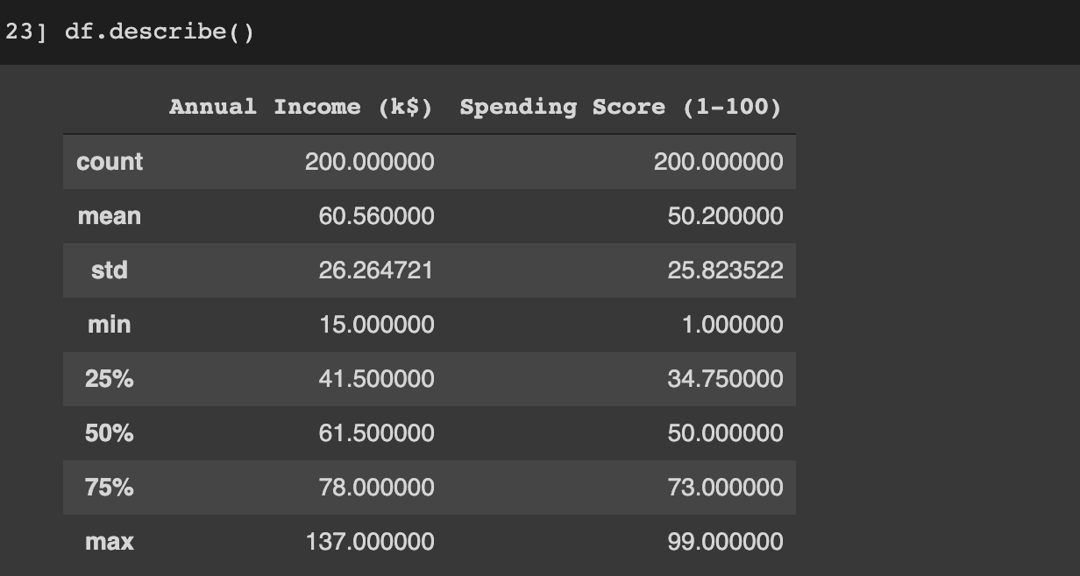
Analysis Continued

Slide 10
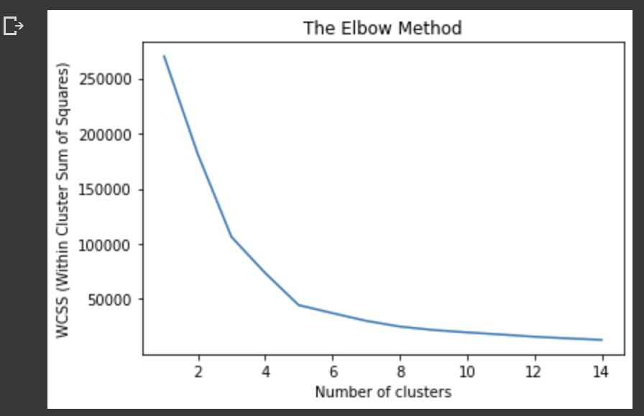
The elbow method

Slide 11
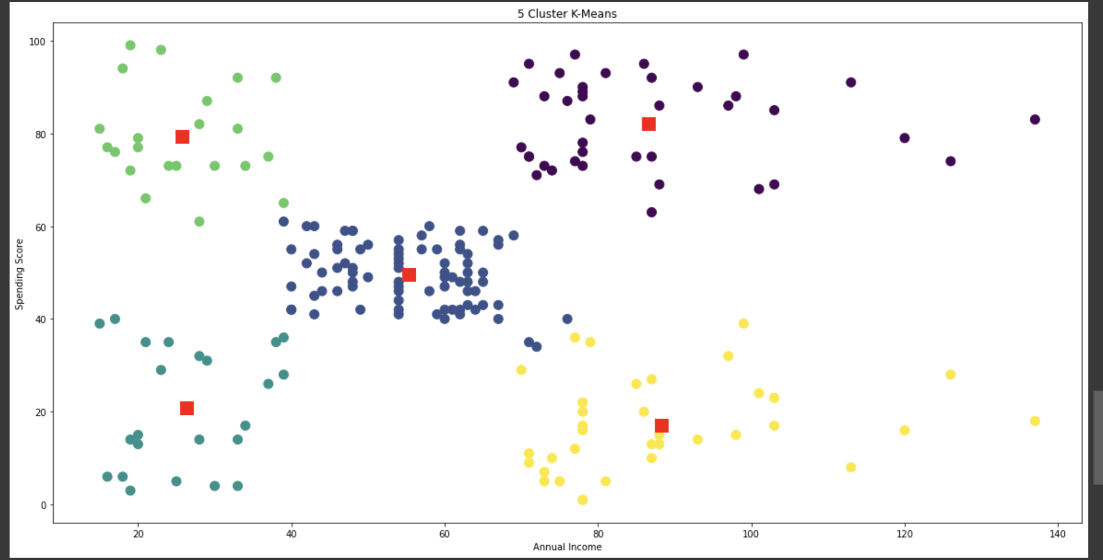
K-means Clusters

Slide 12
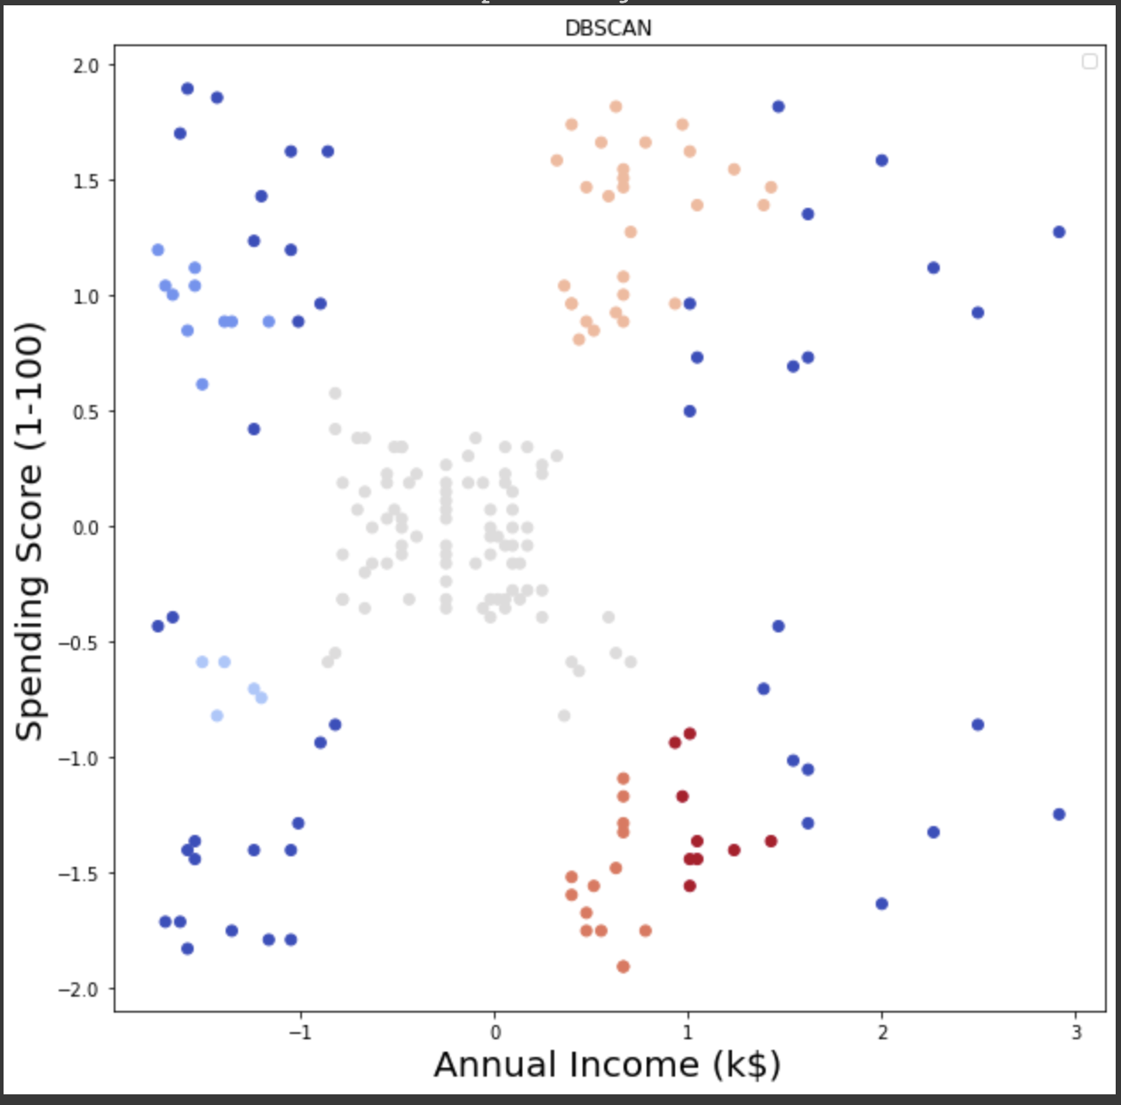
DBSCAN

